Slide 1
Open RAN
Dian Hanifudin Subhi

Slide 2
Outline
Weekly report
Summary of this week’s work
Your work
Conclusion
Your opinion/thought
Action item

Slide 3
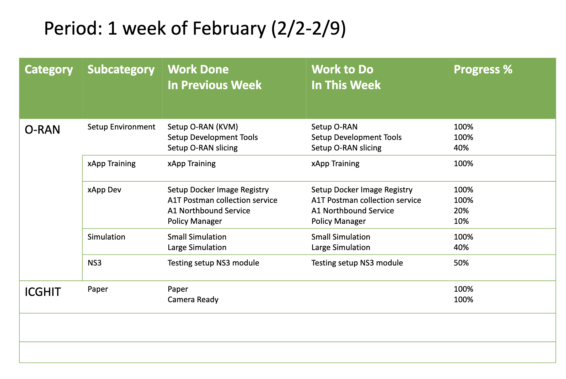
Weekly report

Slide 4
Summary of work this week
Find related projects with O-RAN integration with ns3
Testing setup ns3 with O-RAN

Slide 5
Question to be Answered
What’s the related project o-ran and ns3?
What’s requirement to setup ns3 simulation and o-ran?

Slide 6
Find related projects
Simulate large UE and Cells
e2sim library https://github.com/o-ran-sc/sim-e2-interface
ns3-o-ran-e2 https://github.com/o-ran-sc/sim-ns3-o-ran-e2
ns3-mmwave https://github.com/nyuwireless-unipd/ns3-mmwave

Slide 7
Setup e2sim
Installation instructions
Install dependencies
sudo apt install -y build-essential git cmake libsctp-dev lksctp-tools autoconf automake libtool bison flex libboost-all-dev
git clone https://github.com/o-ran-sc/sim-e2-interface
cd sim-e2-interface/e2sim
mkdir build
cd build
cmake ..
make package
cmake .. -DDEV_PKG=1
make package
dpkg -i e2sim_1.0.0_amd64.deb
dpkg -I e2sim_dev_1.0.0_amd64.deb

Slide 8
Setup ns3-o-ran-e2
Installation instructions
Clone ns3 projects
git clone https://github.com/nsnam/ns-3-dev-git
git checkout ns-3.35
Navigate into contrib directory then clone oran-interface module
git clone https://github.com/o-ran-sc/sim-ns3-o-ran-e2 oran-interface
run ./waf configure --enable-examples
run ./waf

Slide 9
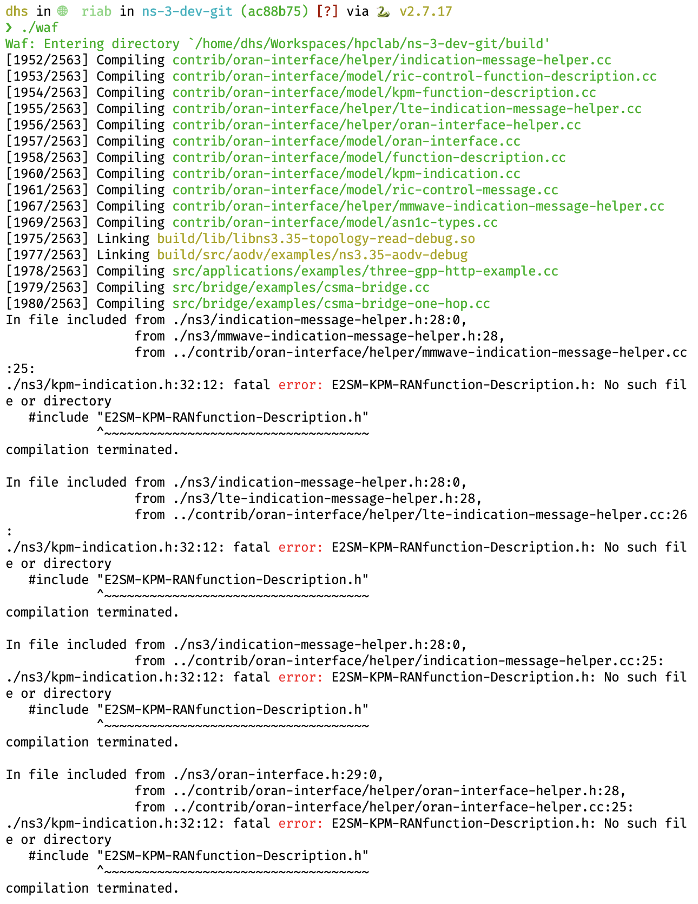
Setup ns3-o-ran-e2
Problems
Missing some headers
Possible solutions -> Find resources to compile ns3-module or related projects
https://github.com/nyuwireless-unipd/ns3-mmwave
https://www.nsnam.org/doxygen/modules.html

Slide 10
Conclusion
O-RAN interface ns3 module failed to install in the current server
There are missing headers that not found when installing O-RAN interface ns3 module

Slide 11
Your opinion/thought
The missing headers are defined in the e2sim library but not compiled
Exclude the source that has problems so the ns3 module can successfully be compiled

Slide 12
Action items
Find resources related to missing headers solution
Find documentation related with ns3 module setup

